Slide 1
Masterclass Statistical Data Analytics & Deep Learning
By:
Dr. Sarita Azad
SMSS, IIT Mandi

Slide 2


Introduction to Data Analytics
By Sarita Azad

Slide 3
outline
Introduction to Data Analytics
Descriptive vs. Inferential Statistics
Data Visualization
Probability Fundamentals
Probability Distributions
Hands-on: Data Exploration with Python

Slide 4
What is Data Analytics?
Data analytics is the process of collecting, organizing, analyzing, and interpreting data to extract meaningful insights.
It helps identify trends, patterns, and relationships within data to support better decision-making.
This field plays a critical role in enhancing efficiency and optimizing outcomes across different sectors.
Applications are widespread—including weather forecasting, finance, healthcare, marketing, and more.
It empowers individuals and organizations to make informed, data-driven decisions for strategic advantage.

Slide 5
Why is data Analytics Important?
Informed Decision-Making: Data analytics transforms raw data into actionable insights, helping individuals and organizations make smarter, evidence-based decisions. E.g. Discovery of climate change. Covid hotspots using infection rates.
Improves Efficiency: It identifies bottlenecks and inefficiencies, allowing businesses to streamline operations and reduce costs.
Forecasting and Prediction: Helps anticipate future trends or outcomes (e.g., weather events, market behaviour, disease outbreaks) using historical data.
Competitive Advantage: Organizations that leverage data can better understand customer needs, personalize services, and outperform competitors.
Cross-Industry Impact: From climate science to finance and healthcare, data analytics is revolutionizing how industries solve problems and deliver value.

Slide 6

MoneyBall (Netflix-2011)
Case Study

Slide 7
Case study: moneyball – winning with data
Billy Beane and Bill James used data and statistics instead of relying on how players looked or played traditionally.
Their aim was to build a strong team with limited money, avoiding costly star players.
Players were chosen based on On-Base Percentage (OBP), not scout opinions.
This led to a team of undervalued but effective players, outperforming expectations.
The strategy inspired others—Boston Red Sox used it to win the 2004 World Series, ending an 86-year drought.
*Billy Beane is a prominent figure in Major League Baseball (MLB) known for revolutionizing baseball management
through data-driven decision-making, while Bill James is a pioneering statistician and writer who developed the field of sabermetrics, the empirical analysis of baseball.

Slide 8
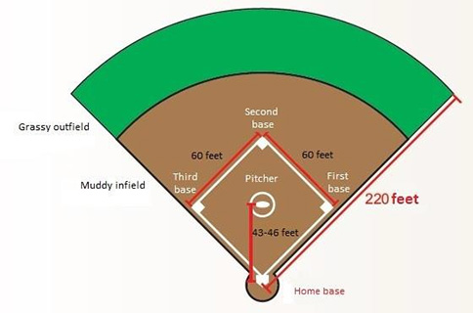
But How?
Can you win games without star players? or What stat truly helps a team win more games? To answer this, we need to rethink how we evaluate players…
In Baseball, On-Base Percentage (OBP) measures how often a player gets on base (hits + walks + hit by pitch)
Why OBP? Unlike Batting Average, OBP rewards disciplined players who get on base in any way. Higher OBP = more baserunners = more scoring opportunities.
So how does OBP actually relate to team success? Let’s analyse real-world data and find out…
$$OBP=\frac{HITS+WALKS+HIT BY PITCH}{AT BATS+WALKS+HIT BY PITCH+SACRIFICE FLIES}$$

Slide 9
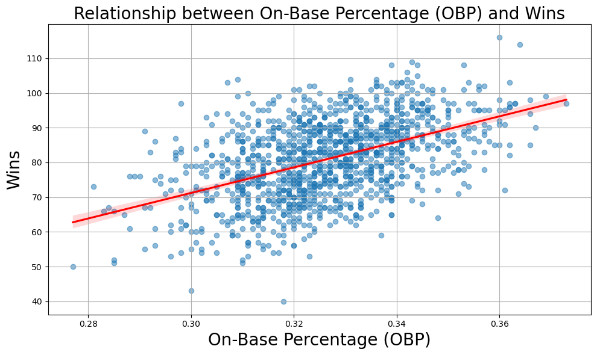
OBP Strongly Predicts Team Wins
Using the analysis from the lab, we can see that with more the OBP, more are the wins.
Strong positive correlation with team wins (r ≈ 0.48).
Moneyball used this insight to build a winning team on a budget.
Did you saw any other stat which correlates with the wins?
0.48
Correlation team stats
Lab File: Case_Study_Moneyball.ipynb

Slide 10
Key takeaways
Data alone isn't magic—but used wisely, it solves real-world problems.
Good decisions require both data and deep domain understanding.
But what types of data exist?

Slide 11
Types of data
Type | Description | Example
Structured | Tabular, rows & columns | Excel sheets, SQL tables
Unstructured | No predefined format | Text, images, videos
Semi-structured | Some organization | XML, JSON
Time Series | Indexed by time | Hourly temperature readings
Spatial | Indexed by space (location) | GPS coordinates, satellite data

Slide 12
Categories of Data Analytics
Descriptive: What happened?
Diagnostic: Why did it happen?
Predictive: What will happen?
Prescriptive: What should be done?

Slide 13
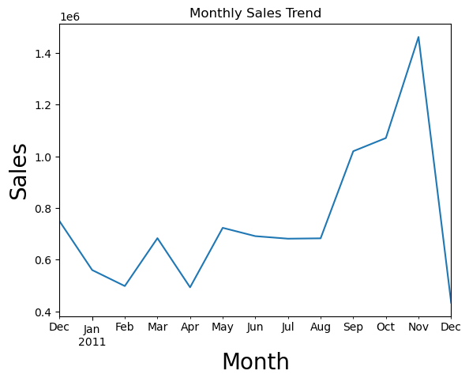
Descriptive Analytics – What happened?
Purpose: Summarize historical data to understand changes over time.
Techniques: Data aggregation, data mining.
Examples: Monthly sales reports, website traffic analysis.
Visualization Tools: Charts, graphs, dashboards.
Key Insights: Monthly sales trends increases by the end of the year indicating festival seasons (Thanksgiving, Christmas, etc.).
Lab File:
lab1.ipynb

Slide 14
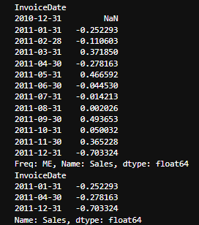
Diagnostic Analytics – Why did it happen?
Purpose: Investigate data to determine causes of past outcomes.
Techniques: Drill-down, data discovery, correlations.
Examples: Analysing why sales dropped in a particular quarter.
Tools: Python, Statistical analysis software, root cause analysis.
Key Insights: Sales declined in the months of April, December and January, likely due to end of financial year and festival season respectively.
Lab File:
lab1.ipynb

Slide 15
Predictive Analytics – What is likely to happen?
Purpose: Forecast future trends based on historical data.
Techniques: Machine learning, statistical modelling.
Examples: Predicting customer churn, sales forecasting.
Tools: Regression analysis, time series analysis.
Key Insights: what will be the likely sales in the next upcoming months

Slide 16
Prescriptive Analytics – What should we do?
Purpose: Recommend actions to achieve desired outcomes.
Techniques: Optimization, simulation algorithms.
Examples: Recommending product pricing strategies, supply chain optimization.
Tools: Decision analysis tools, AI algorithms.
Key Insights: how can we mitigate potential losses and increase benefits.

Slide 17






Data analytics lifecycle
6 Interpretation & Deployment
1 Collection
Drawing actionable conclusions from results.
Communicating findings with stakeholders.
Optionally, deploying models in dashboards or applications.
Gathering data from various sources (databases, APIs, sensors, user logs).
Includes structured and unstructured formats.
Example: Sales logs, weather data, social media posts.
1
6
2
5 Model Evaluation
2 Preprocessing
Validating performance using metrics like RMSE, accuracy, F1-score.
Avoiding underfitting and overfitting.
Example: Cross-validation, test-train split.
Cleaning missing values, removing outliers, fixing inconsistencies.
Data transformation and normalization.
Example: Removing nulls, converting time formats, standardizing units.
5
3
4 Model Building
4
3 Exploratory Data Analysis
Applying statistical or machine learning models to extract insights or make predictions.
Techniques: Regression, classification, clustering, forecasting.
Identifying patterns, trends, anomalies.
Visualizations and summary statistics.
Tools: pandas, matplotlib, seaborn.
Notes:
© Copyright PresentationGO.com – Free Templates & Infographics for PowerPoint and Google Slides

Slide 18
1. Collection
The process of gathering raw data from various sources to enable analysis and decision-making.
🔍 Key Data Sources
🗄️ Databases – SQL/NoSQL systems (e.g., MySQL, MongoDB)
🌐 APIs (Realtime) – Services like Twitter API, OpenWeatherMap
📡 Sensors/IoT (Realtime) – Smart devices, climate sensors, GPS
🧾 User Logs – Web/app clickstreams, transaction logs
🌍 Examples
🛍️ Retail: Sales logs, CRM data
☁️ Climate Science: Hourly rainfall, temperature sensors
ECMWF ERA5 Reanalysis: Provides hourly estimates of atmospheric, land, and oceanic climate variables.
NASA Earthdata: Offers access to a vast collection of Earth science data.
📱 Social Media: Tweets, comments, likes
X (formerly Twitter) API for Academic Research: Enables access to public conversation data for research purposes.
Meta Graph API: Allows retrieval of data from Facebook and Instagram platforms.

Slide 19
2. Preprocessing
The process of transforming raw data into a clean and structured format suitable for analysis and modeling.
🔍 Key Steps in Data Preprocessing
Data Cleaning
Handling Missing Values: Techniques like mean/median imputation or deletion.
Removing Duplicates: Ensuring each record is unique.
Correcting Inconsistencies: Standardizing formats (e.g., date formats, string cases).
Data Integration
Combining Data: Merging data from multiple sources (e.g., databases, APIs).
Resolving Conflicts: Addressing discrepancies in data from different sources.
Data Transformation
Normalization/Standardization: Scaling features to a similar range.
Encoding Categorical Variables: Converting categories into numerical values using techniques like one-hot encoding.
Data Cleaning/Reduction
Feature Selection: Identifying and retaining the most relevant variables.
Dimensionality Reduction: Techniques like PCA to reduce the number of features while preserving variance.

Slide 20
Preprocessing 2.1 Data Cleaning
ss
ss
ss
ss
ss
ss
Handling Missing Values
Removing Duplicates
Correcting Inconsistencies
Deletion: Remove records with missing values when they are minimal and random.
Imputation:
Mean/Median Imputation: Replace missing numerical values with the mean or median of the column.
Mode Imputation: For categorical variables, replace missing values with the mode.
Advanced Methods: Utilize techniques like K-Nearest Neighbors (KNN) or Multiple Imputation by Chained Equations (MICE) for more accurate estimations.
Standardizing Formats:
Dates: Ensure uniform date formats (e.g., converting all to YYYY-MM-DD).
Text Cases: Standardize text to a consistent case (e.g., all lowercase).
Resolving Typos and Errors:
Correct misspellings and typographical errors.
Ensure consistent naming conventions across the dataset.
Identification: Detect duplicate records using unique identifiers or a combination of fields.
Removal: Eliminate exact or near-duplicate entries to prevent skewed analyses.

Slide 21
Preprocessing 2.2 Data Integration
ss
ss
🛠️ Tools & Techniques
ETL Processes: Extract, Transform, Load workflows for systematic data integration.
Data Virtualization: Accessing and integrating data in real-time without physical movement.
Integration Platforms: Utilizing tools like Talend, Informatica, or Apache NiFi for seamless data integration
ss
ss
ss
ss
🔄 Combining Data from Multiple Sources
⚠️ Resolving Conflicts in Data Integration
Databases: Merging data from relational (e.g., MySQL, PostgreSQL) and non-relational (e.g., MongoDB) databases.
APIs: Integrating data retrieved from web services and APIs, such as RESTful APIs.
Files and Spreadsheets: Consolidating data from CSV, Excel, and other file formats.
Cloud Services: Aggregating data from cloud-based platforms like Salesforce, Google Analytics, etc.
IoT Devices: Incorporating data from sensors and smart devices.
Schema Mapping: Aligning different data models and structures to a common schema.
Data Transformation: Standardizing data formats, units, and nomenclature.
Duplicate Detection: Identifying and removing redundant records.
Data Fusion: Combining records referring to the same entity into a single, coherent representation.
Conflict Resolution: Addressing discrepancies and inconsistencies between data sources.
ss
ss
🌐 Real-World Applications
Business Intelligence: Creating comprehensive dashboards by integrating sales, marketing, and customer data.
Healthcare: Combining patient records from various departments for holistic care.
E-commerce: Merging product, inventory, and customer data to enhance user experience.

Slide 22
Preprocessing 2.3 Data Transformation
ss
ss
🛠️ Tools & Techniques
ETL Processes: Extract, Transform, Load pipelines using tools like Apache NiFi or Talend.
Data Virtualization: Access and integrate data in real-time without moving it, using platforms like Denodo.
Data Lakes: Store structured and unstructured data at scale, enabling integration and analysis.
ss
ss
ss
ss
🔍 Key Processes in Data Integration
🗂️ Handling Various Data Formats
Combining Data
Merging Diverse Sources: Integrate data from databases, APIs, and files.
Example: Merging sales data from SQL databases with customer feedback from JSON APIs.
Resolving Conflicts
Schema Mapping: Align differing data structures and field names.
Data Deduplication: Identify and remove duplicate records.
Conflict Resolution: Address discrepancies in data values from different sources.
Format | Description | Libraries
GRIB | Binary format for meteorological data. | cfgrib, ecCodes
NetCDF | Format for array-oriented scientific data. | netCDF4, xarray
JSON | Lightweight, human-readable format, common in APIs. | json, pandas
ss
ss
🌍 Real-World Example
Climate Research: Integrating GRIB files from ECMWF with NetCDF datasets from NASA to model climate patterns.
Social Media Analysis: Combining JSON data from Twitter API with sales data to assess marketing campaign effectiveness.
Practical has been shown in lab exercises

Slide 23


Preprocessing 2.4 Data Cleaning/reduction
ss
ss
🔠 Encoding Categorical Variables
One-Hot Encoding
Purpose: Converts categorical variables into a binary matrix.
Method: Creates a new binary column for each category.
Use Case: When categorical variables are nominal (no intrinsic order).
ss
ss
ss
ss
📏 Feature Scaling
📏 Feature Scaling
Normalization (Min-Max Scaling)
Purpose: Rescales features to a fixed range, typically [0, 1].
Formula:
Use Case: When features have different scales and the algorithm assumes equal importance of all features.
Standardization (Z-score Normalization)
Purpose: Centers features around the mean with unit variance..
Formula:
Use Case: When features are normally distributed; beneficial for algorithms like logistic regression and neural networks.
ss
ss
✅ Best Practices
Normalization is sensitive to outliers; use when the distribution is unknown.
Standardization is robust to outliers; use when data is normally distributed.
One-Hot Encoding can lead to high dimensionality; consider dimensionality reduction techniques if necessary.
$$x_{norm}=\frac{x−x_{min}}{x_{max}−x_{min}}$$
$$x_{std}=\frac{x−μ}{σ}$$

Slide 24
3. Exploratory Data Analysis
Exploratory Data Analysis (EDA) is the process of analyzing datasets to summarize their main characteristics, often using visual methods. It helps in uncovering patterns, spotting anomalies, testing hypotheses, and checking assumptions through statistical summaries and graphical representations.
🎯 Objectives of EDA
Understand Data Structure: Gain insights into the data's distribution and features.
Detect Patterns and Relationships: Identify correlations and trends among variables.
Spot Anomalies or Outliers: Discover data points that deviate significantly from others.
Test Hypotheses: Formulate and validate assumptions about the data before formal modeling.

Slide 25
Exploratory data analysis 3.1 Common eda techniques
ss
ss
ss
ss
ss
ss
Bivariate Analysis
Multivariate Analysis
Univariate Analysis
Purpose: Analyze individual variables to understand their distribution.
Methods:
Histograms: Visualize the frequency distribution of a variable.
Box Plots: Identify the median, quartiles, and potential outliers.
Summary Statistics: Compute mean, median, mode, variance, etc.
Purpose: Explore relationships between two variables.
Methods:
Scatter Plots: Assess the correlation between two continuous variables.
Bar Charts: Compare categorical variables.
Correlation Coefficients: Quantify the strength and direction of relationships.
Purpose: Examine interactions among more than two variables.
Methods:
Heatmaps: Visualize correlation matrices.
Pair Plots: Display pairwise relationships between variables.
Dimensionality Reduction: Techniques like PCA to reduce complexity.
🛠️ Tools & Libraries
Python | R
pandas: Data manipulation and analysis. | ggplot2: Advanced plotting system.
matplotlib & seaborn: Data visualization. | dplyr: Data manipulation.
plotly: Interactive visualizations. | SmartEDA: Automated EDA
🌐 Real-World Applications
Healthcare: Analyzing patient data to identify risk factors.
Finance: Detecting fraudulent transactions through pattern recognition.
Retail: Understanding customer purchasing behavior to optimize inventory.

Slide 26
4. Model building
Model building involves applying statistical or machine learning algorithms to processed data to extract insights, identify patterns, or make predictions. This step transforms data into actionable intelligence that supports decision-making.
ss
ss
ss
ss
ss
ss
ss
ss
Regression
Classification
Clustering
Forecasting
Purpose: Predict continuous numerical outcomes.
Examples: Predicting housing prices based on features like size and location.
Estimating sales revenue based on advertising spend.
Algorithms: Linear Regression, Ridge Regression, Lasso Regression.
Purpose: Categorize data into predefined classes or labels.
Examples: Email spam detection (spam vs. not spam).
Diagnosing diseases based on patient symptoms.
Algorithms: Logistic Regression, Decision Trees, Support Vector Machines.
Purpose: Group similar data points without predefined labels.
Examples: Customer segmentation in marketing. Grouping news articles by topic.
Algorithms: K-Means, Hierarchical Clustering, DBSCAN.
Purpose: Predict future data points based on historical trends.
Examples: Forecasting monthly sales figures.
Predicting stock market trends.
Algorithms: ARIMA, Prophet, Exponential Smoothing.
Python: scikit-learn, statsmodels, xgboost, prophet.
R: caret, forecast, randomForest.
Platforms: Azure Machine Learning, Google Cloud AI Platform, Amazon SageMaker.
Finance: Credit scoring, fraud detection.
Healthcare: Disease prediction
Retail: Inventory management, customer churn prediction.
Marketing: Customer segmentation, campaign response modeling.
🛠️ Tools & Libraries
🌐 Real-World Applications

Slide 27
5. Model evaluation
ss
ss
🔄 Validation Techniques
Train-Test Split: Dividing the dataset into separate training and testing sets (e.g., 80/20 split) to evaluate model performance.
K-Fold Cross-Validation: Partitioning the data into 'k' subsets and training/testing the model 'k' times, each time using a different subset as the test set and the remaining as the training set. This technique provides a more robust estimate of model performance.
Model evaluation assesses how well a model performs on unseen data. It helps in understanding the model's predictive power and generalization capability.
ss
ss
ss
ss
📏 Key Evaluation Metrics
📏 Key Evaluation Metrics
For Regression Models:
Root Mean Squared Error (RMSE): Measures the average magnitude of the errors between predicted and actual values.
Mean Absolute Error (MAE): Average of absolute differences between predicted and actual values.
R-squared (R²): Proportion of variance in the dependent variable predictable from the independent variables.
For Classification Models:
Accuracy: Proportion of correct predictions over total predictions.
Precision: Proportion of true positives over total predicted positives.
Recall (Sensitivity): Proportion of true positives over total actual positives.
F1-Score: Harmonic mean of precision and recall.
Confusion Matrix: Table showing true vs. predicted classifications.
ss
ss
⚠️ Avoiding Overfitting and Underfitting
Overfitting: Model performs well on training data but poorly on unseen data.
Underfitting: Model performs poorly on both training and unseen data.
Solution: Use cross-validation and regularization techniques to balance model complexity.

Slide 28
6. Interpretation & Deployment
ss
ss
ss
ss
ss
ss
🧠 Interpretation: From Predictions to Insights
🗣️ Communicating Findings to Stakeholders
🚀 Deployment: Bringing Models to Production
Understand Model Outputs: Analyze feature importance, decision boundaries, and prediction confidence to comprehend model behavior.
Contextualize Findings: Relate model results to business objectives and real-world implications.
Validate Assumptions: Ensure that the model's assumptions align with domain knowledge and data characteristics.
Tailor the Message: Adapt explanations to the audience's technical background.
Use Visual Aids: Employ charts, graphs, and dashboards to illustrate key insights.
Highlight Impact: Emphasize how the model's insights can drive business decisions and outcomes.
Address Limitations: Be transparent about the model's constraints and areas of uncertainty.
Model Packaging: Serialize the trained model using formats like Pickle, Joblib, or ONNX.
API Development: Create RESTful APIs using frameworks like Flask or FastAPI to serve model predictions.
Integration: Embed the model into existing systems or workflows, ensuring seamless operation.
Monitoring: Implement monitoring tools to track model performance and data drift over time.
🛠️ Tools & Platforms for Deployment
Cloud Services: AWS SageMaker, Google Cloud AI Platform, Azure Machine Learning.
MLOps Frameworks: Kubeflow, MLflow, TensorFlow Serving.
Visualization Tools: Tableau, Power BI, Streamlit for creating interactive dashboards.

Slide 29


Tools & Applications of Data Analytics
Tools
Uses
Languages | Python, R, SQL, and many more
Libraries | pandas – data manipulation, numpy – numerical ops matplotlib, seaborn – visualizations jupyter – notebooks for hands-on analysis
Climate Science | Predict rainfall and monitor climate patterns
Finance | Risk assessment, fraud detection, stock forecasting
Healthcare | Disease trend tracking, patient risk prediction
Retail | Customer segmentation, demand forecasting
Master the tools and you'll unlock insights across any domain—from weather to wallets!

Slide 30
Summarizing Introduction to data analytics
Data alone isn't magic—but used wisely, it solves real-world problems.
Data analytics helps turn raw data into actionable insights. Knowing the type and lifecycle of data is key.

Slide 31


Before We Dive Into Statistics…
ss
ss
ss
ss
📌 Two Fundamental Questions in Data Analysis:
🎯 Why Statistics?
Prediction
Once we’ve collected and cleaned our data, we need tools to summarize, analyze, and make decisions from it.
Statistics is the language we use to make sense of our data.
What do we know about the data we have?
→ This is where Descriptive Statistics helps.
What can we infer about a bigger picture from this data?
→ This is the job of Inferential Statistics.
Raw Data
Let’s now explore the two core pillars of statistical thinking — Descriptive and Inferential Statistics.

Slide 32
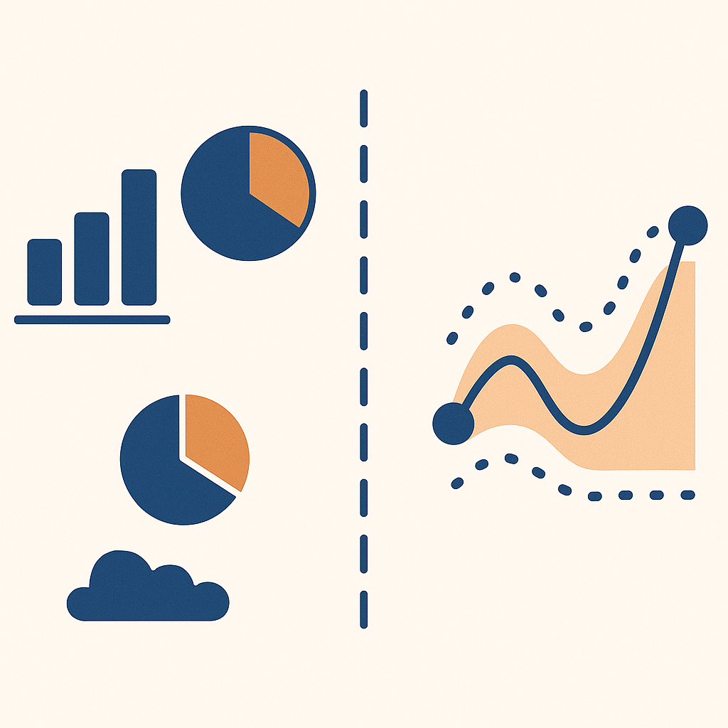
Descriptive vs. Inferential Statistics

Slide 33
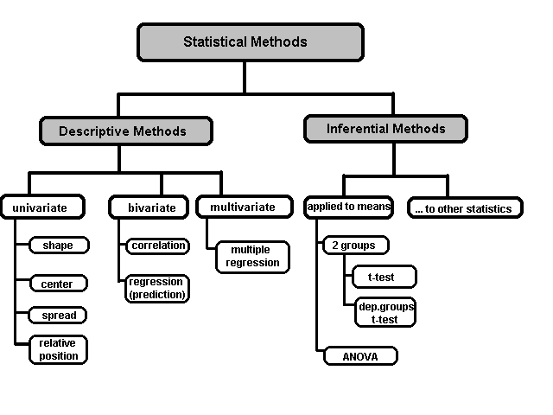
A Taxonomy of Statistics

Slide 34
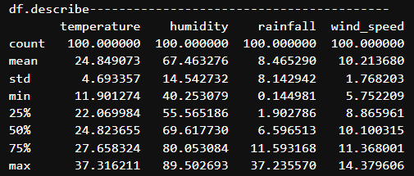
Descriptive Statistics
Summarize and describe features of a dataset.
Descriptive statistics are broken down into measures of central tendency (Mean, Median, Mode) and measures of variability (Range, Variance, Std Dev, IQR).
Example: "The average temperature in June was 24°C.“
🧠 Use Case: Descriptive statistics helps explore what the data says
pandas.DataFrame.describe - Generate descriptive statistics.

Slide 35
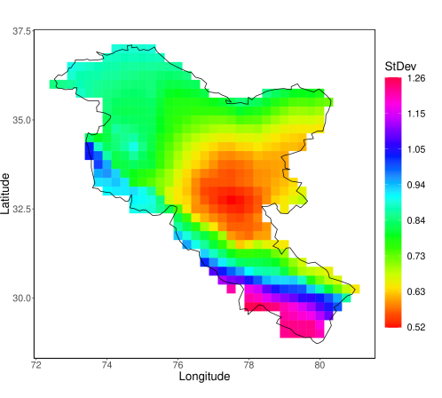
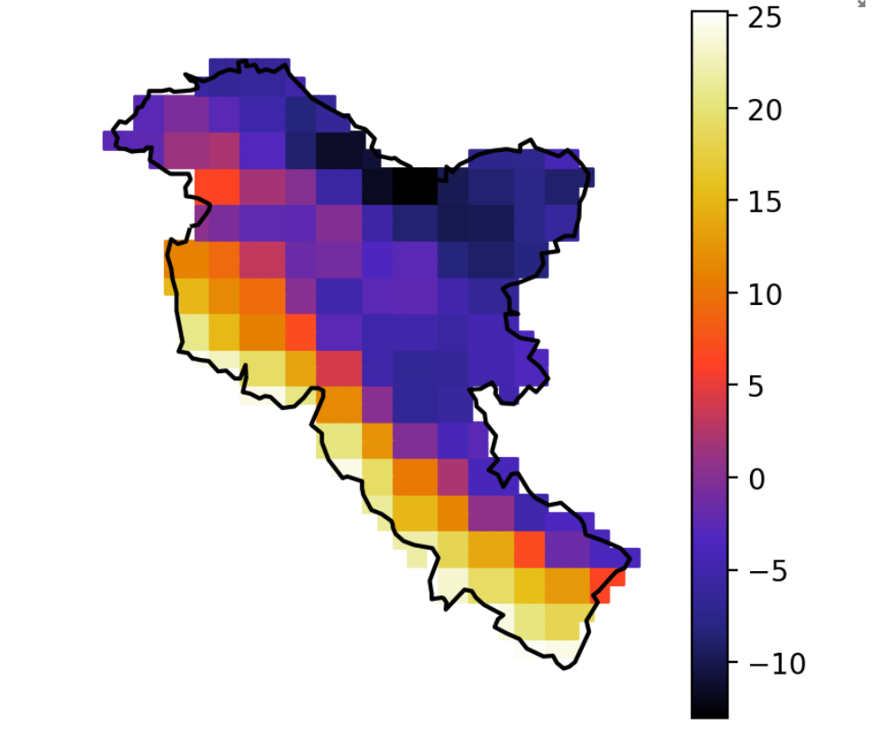
Descriptive Statistics
Mean and Standard Deviations of Temperature over Himalayas

Slide 36
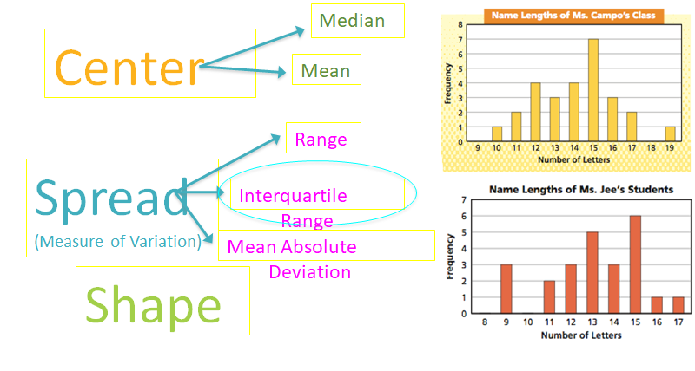
Statistical Description of Data
Shape – Center - Spread
Statistics describes a numeric set of data by its
Center
Variability
Shape
When we gather data, we want to uncover the “information” in it. One easy way to do that is to think of: “Shape –Center- Spread”
Shape – What is the shape of the histogram?
Center – What is the mean or median?
Spread – What is the range or standard deviation?

Slide 37
Shape: The “shape” of the data is called its “distribution”?
If mean = median = mode, the shape of the distribution is symmetric.
If mode < median < mean, the shape of the distribution trails to the right, is positively skewed.
If mean < median < mode, the shape of the distribution trails to the left, is negatively skewed.
Distributions of various “shapes” have different properties and names such as the “normal” distribution, which is also known as the “bell curve” (among mathematicians it is called the Gaussian Distribution).

Slide 38
Normal Distribution
Mode
Median
Mean

Slide 39


Non-Normal Distribution
Mode
Negative Skew
Median
Mean

Slide 40
Non-Normal Distribution
Mode
Positive Skew
Median
Mean

Slide 41
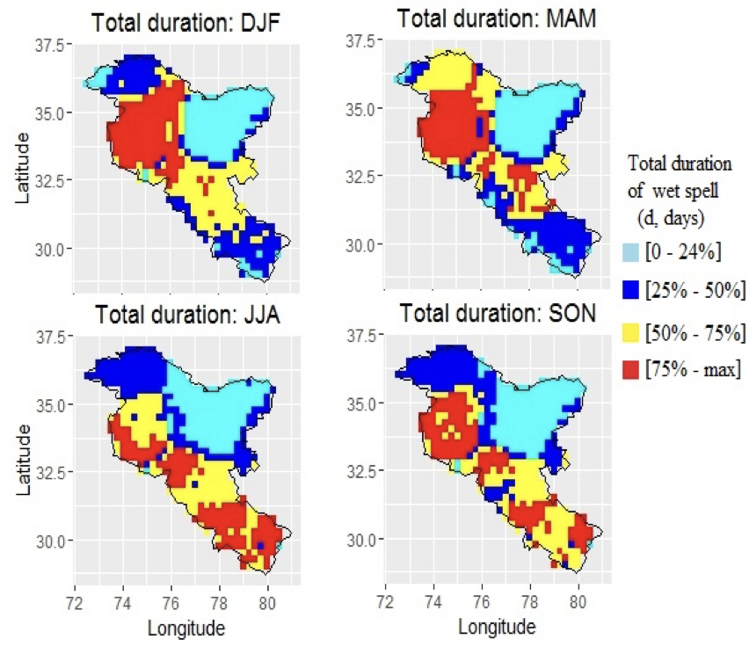
Use of quartiles in research
To find the quartile values we -
Put the data in order
Split the data into two equal halves
Find the middle value of each half. These values are the quartiles.
Interquartile range = Upper quartile – Lower quartile

Slide 42
Problem solving and reasoning
The ages (in years) of the members of a branch of a football supporters club are given in the table below.
There are 180 members in the branch. How many are aged between 54 and 19 years old?
Solution
54 and 19 are the values of the quartiles.
There are 50% of the values lying between the quartiles
50% of 180 = 90
Youngest | Lower quartile | Median | Upper quartile | Oldest
2 | 19 | 31 | 54 | 74

Slide 43
Deciles and Percentiles
Deciles: If data is ordered and divided into 10 parts, then cut points are called Deciles
Percentiles: If data is ordered and divided into 100 parts, then cut points are called Percentiles. 25th percentile is the Q1, 50th percentile is the Median (Q2) and the 75th percentile of the data is Q3.
Coefficient of Variation: The standard deviation of data divided by it’s mean. It is usually expressed in percent.
In notations, percentiles of a data is the ((n+1)/100)pth observation of the data, where p is the desired percentile and n is the number of observations of data.
Coefficient of Variation =

Slide 44
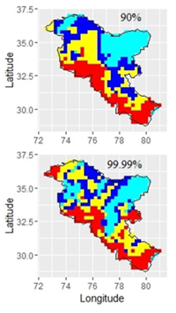
Application of percentile to climate data
Importance of extremes

Slide 45
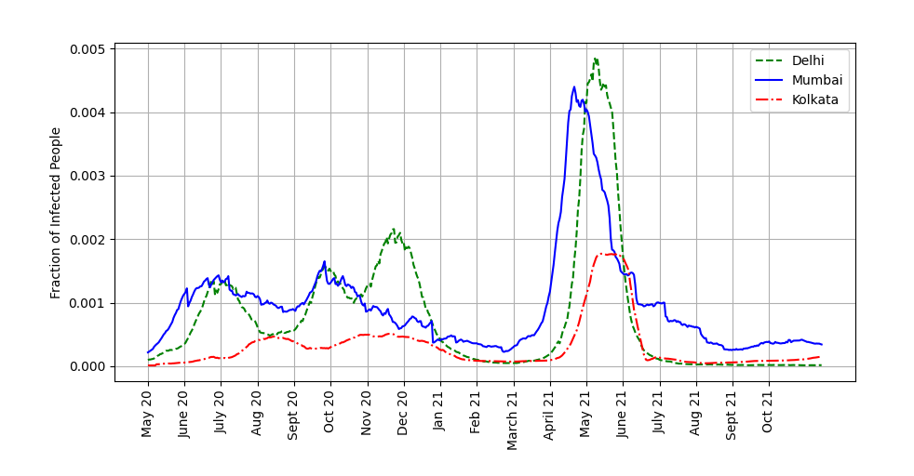
A data analysis of COVID-19
Note: Two waves are seen

Slide 46
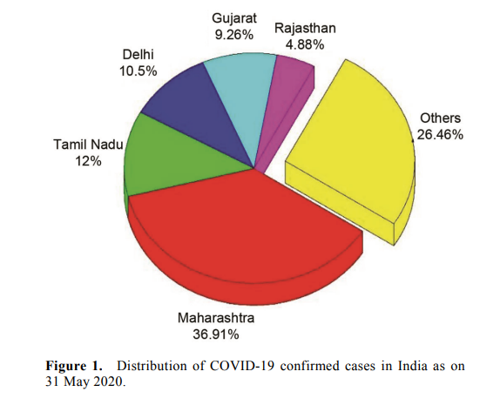

Slide 47
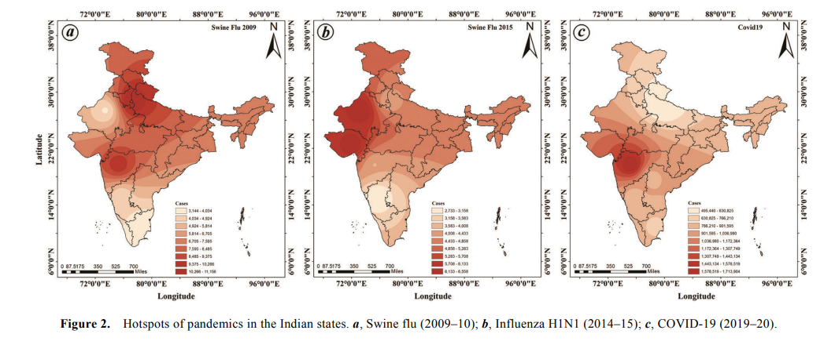

Slide 48
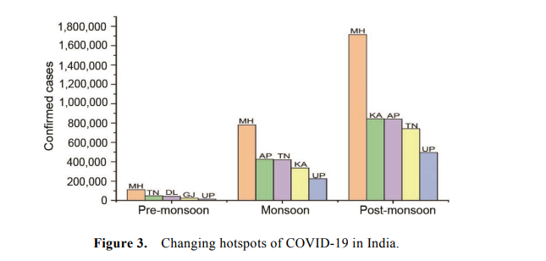

Slide 49
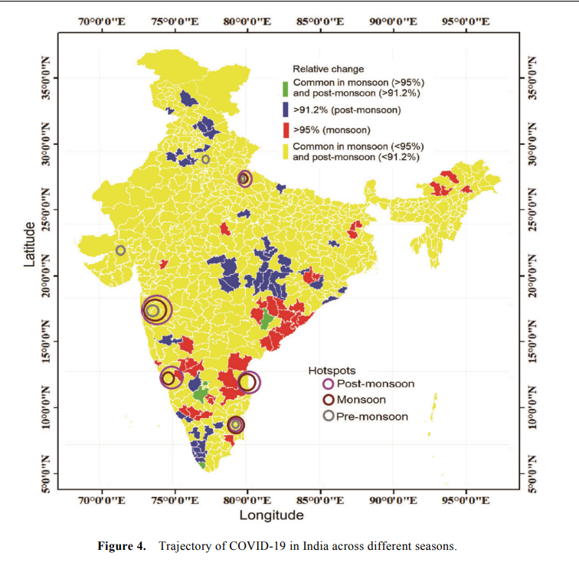

Slide 50
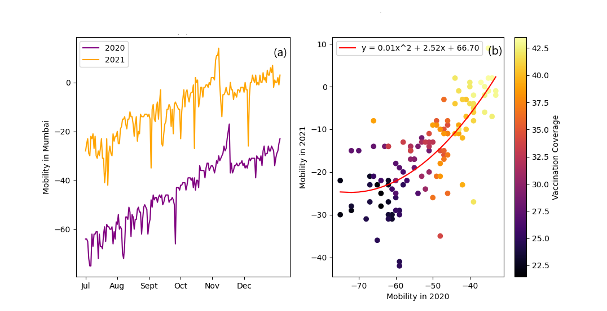

Slide 51
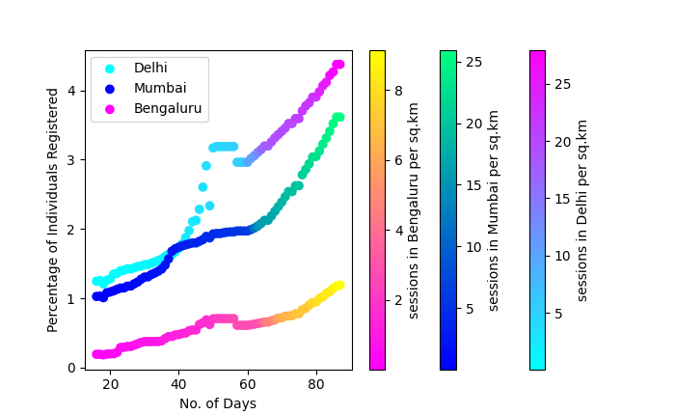

Slide 52
Inferential Statistics
Make predictions or inferences about a population based on a sample.
Techniques: Hypothesis Testing, Confidence Intervals, Regression Analysis.
Example: "We are 95% confident the average temperature next June will be between 29–31°C.“
🧠 Use Case: Inferential statistics helps answer what it implies

Slide 53

Introduction to probability

Slide 54
But Before that!!!! Why Probability?
You might be wondering why do we need probability in the course of Data Analytics and you are right!!
Everything we have seen till now, has one thing and only thing in the focus of attention, DATA.
Given the amount of data that exists, it is impossible to learn about the information in the data by just looking at raw values.
But one axiom which stands true for every DATA is that it follows one or the other distribution (or comes from a part of distribution).
So, where there is distribution, there exists probability.

Slide 55
Probability Fundamentals
Probability measures the likelihood of an event occurring.
Always between 0 and 1
0 = Impossible event, 1 = Certain event
🧩 Key Concepts
Experiment: An action with uncertain outcomes (e.g., tossing a coin)
Sample Space (S): All possible outcomes
e.g., Tossing a coin → S = {Heads, Tails}
Event (E): A subset of the sample space
e.g., Getting a Head → E = {Heads}

Slide 56
Discrete vs Continuous Random Variables
🔢 Discrete Random Variables
Countable outcomes
e.g., Number of heads in 3-coin tosses
The entity used to represent all the discrete probabilities is known as the probability mass function or PMF.
📈 Continuous Random Variables
Infinite outcomes in a range
e.g., Height, temperature
The entity used to represent all the continuous probabilities is known as the probability density function or PDF.
Example use: Medical diagnostics, spam filters, etc.

Slide 57
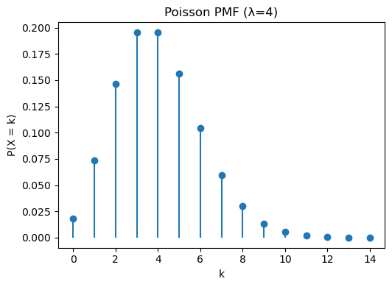
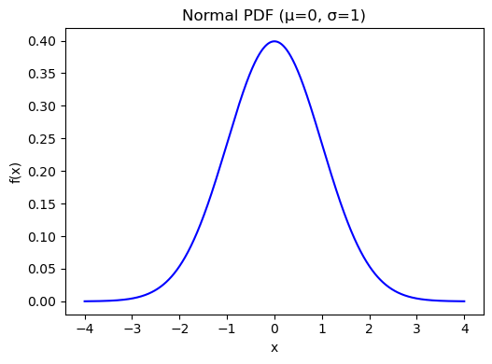
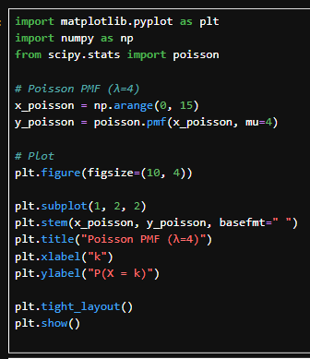
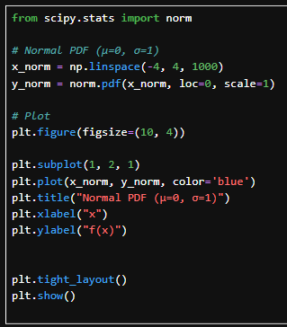
Now let’s come back to - distributions
📦 Definition
A distribution tells us how the values of a random variable are spread out. It helps us understand likelihoods of different outcomes.
Remember, Two Key Types of functions we studied earlier….
Probability Mass Function (PMF): For discrete variables
Probability Density Function (PDF): For continuous variables
Hence there exists two categories of distributions.
PMF
PDF
ss
ss

Slide 58
Types of distributions
ss
ss
ss
ss
Common Discrete Distributions
Common Continuous Distributions
🎲 Bernoulli Distribution
Two outcomes: success (1) or failure (0)
Example: Tossing a biased coin
🎯 Binomial Distribution
Repeated Bernoulli trials
Example: 10 coin tosses, count of heads
⚡ Poisson Distribution
Models number of events in a fixed time/space
Example: Number of emails received in an hour
🛎️ Normal Distribution
Bell-shaped curve, symmetric
Fully defined by mean (μ) and standard deviation (σ)
⏳ Exponential Distribution
Models time between events
Memoryless property
🎯 Uniform Distribution
All outcomes equally likely over a range
Example: Random number between 0 and 1
Wait!! But which one do I like?

Slide 59
Why Are Distributions So Important?
There is no ‘one shoe fits all’ strategy when applying/finding distribution of any data. But given the cases previously one can generalize.
Distributions are particularly useful because……
They summarize the shape of data
They form the basis of statistical inference
Help us calculate probabilities, z-scores, and critical regions
Real-world processes almost always follow a known or approximate distribution
Why can’t we just rely on data points — why do we need to know the distribution?

Slide 60
Why Knowing the Data Distribution Matters
ss
ss
ss
ss
📊 Distributions = Shape of Reality
🌐 Data ≠ Understanding
A distribution captures the pattern in data: center, spread, skew, peaks
Different distributions lead to different inferences and decisions
Raw data only shows what happened — not how likely future events are
To generalize beyond the observed data, we need to know: What is typical? What is rare? What is likely?
Normal (symmetric) | Predict average values with high confidence
Skewed (e.g., Exponential) | Expect more small events, rare large events
Multimodal | May need multiple models, not one

Slide 61
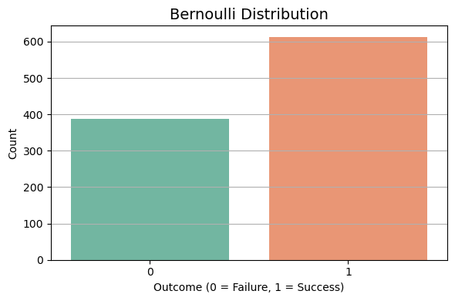
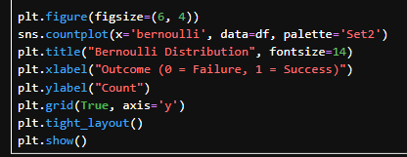
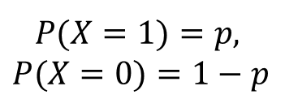
Bernoulli Distribution
🧠 Key Idea:
One trial, two outcomes: Success (1) or Failure (0)
📈 PMF:
🧪 Example:
Tossing a biased coin
Predicting if a machine fails or not
$$P(X=0)=1−pP(X=1)=p,$$
ss
ss
Lab File: lab1.ipynb

Slide 62
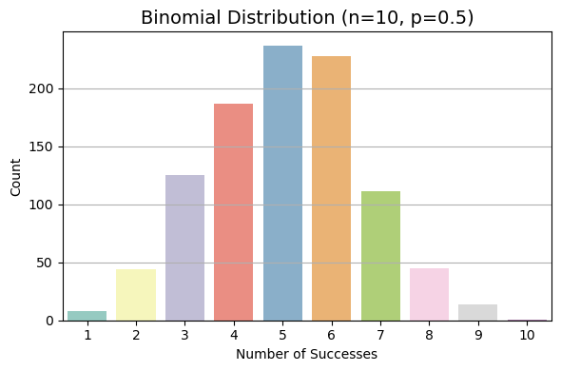
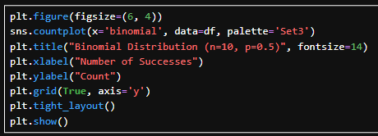

Binomial Distribution
🧠 Key Idea:
Sum of n independent Bernoulli trials
📈 PMF:
🧪 Example:
Number of heads in 10 coin tosses
Number of customers who buy out of 100 contacted
$$P\left(X=k\right)= \left({n \atop k}\right)p^{k}{\left(1−p\right)}^{n−k}$$
ss
ss
Lab File: lab1.ipynb

Slide 63
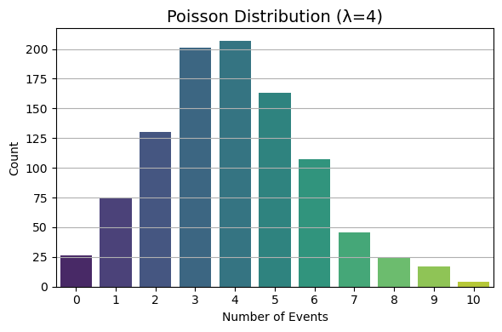
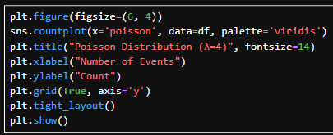
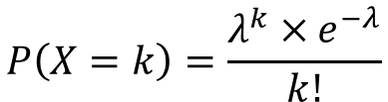
Poisson Distribution
🧠 Key Idea:
Models count of events in fixed time/space when events happen independently
📈 PMF:
🧪 Example:
Number of calls to a call center in 1 hour
Number of typos per page in a book
$$P\left(X=k\right)=\frac{λ^{k}×e^{−λ}}{k!}$$
ss
ss
Lab File: lab1.ipynb

Slide 64
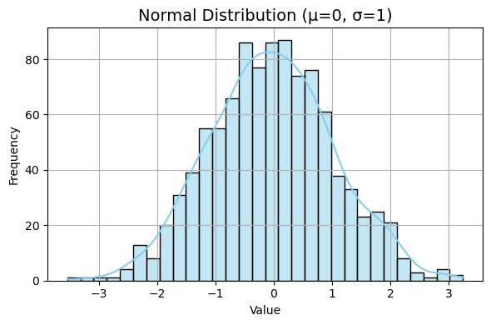
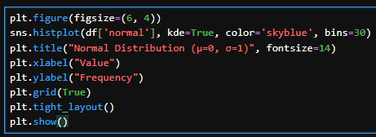
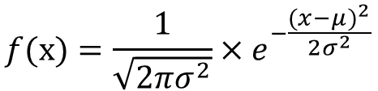
Normal Distribution
🧠 Key Idea:
Bell-shaped curve, symmetric around the mean (μ)
📈 PMF:
🧪 Example:
Heights of people.
Errors in measurements
$$f(x)=\frac{1}{\sqrt{2πσ^{2}}}×e^{−\frac{{(x−μ)}^{2}}{2σ^{2}}}$$
ss
ss
Lab File: lab1.ipynb

Slide 65
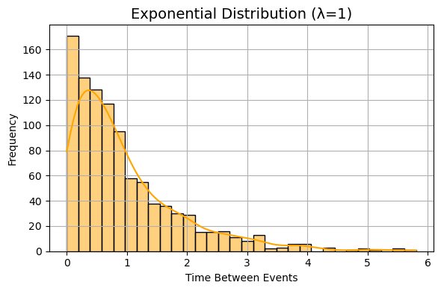
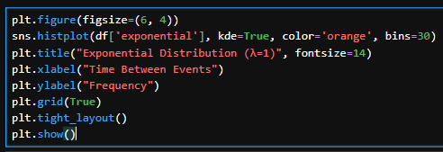

Exponential Distribution
🧠 Key Idea:
Models time between events in a Poisson process
Has memoryless property
📈 PMF:
🧪 Example:
Time between arrivals at an ATM
Lifespan of electronic components
$$f\left(x\right)=λe^{−λx}, x>0$$
ss
ss
Lab File: lab1.ipynb

Slide 66
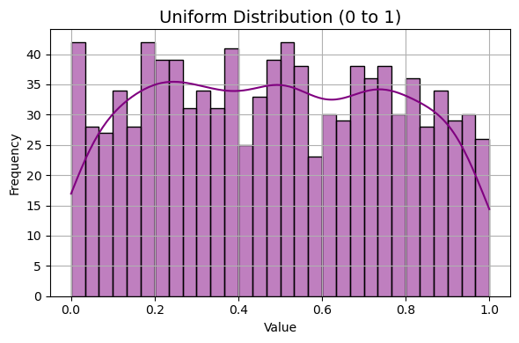
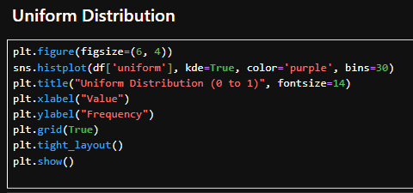

Uniform Distribution
🧠 Key Idea:
All outcomes are equally likely over a continuous range
📈 PMF:
🧪 Example:
Picking a random number between 0 and 1
Rolling a fair die (discrete version)
$$f\left(x\right)=\frac{1}{b−a}, a≤x≤b$$
ss
ss
Lab File: lab1.ipynb

Slide 67
How to Find the Best-Fitting Distribution

Slide 68
🧪 Step-by-Step: How to Find the Best-Fitting Distribution
👀
🛠️
⚖️
ss
ss
ss
ss
ss
ss
3. Compare Distributions using Goodness-of-Fit Tests
1. Visual Inspection (First Look)
2. Fit Common Distributions
Use plots to get an initial sense
Use scipy.stats to fit multiple candidate distributions:
Kolmogorov–Smirnov (K-S) Test
🧮
🤖
ss
ss
ss
ss
5. Use Distribution Fitting Libraries
4. Q-Q Plot (Quantile-Quantile Plot)
Check linearity between theoretical & empirical quantiles
Try the fitter package for automated comparison

Slide 69
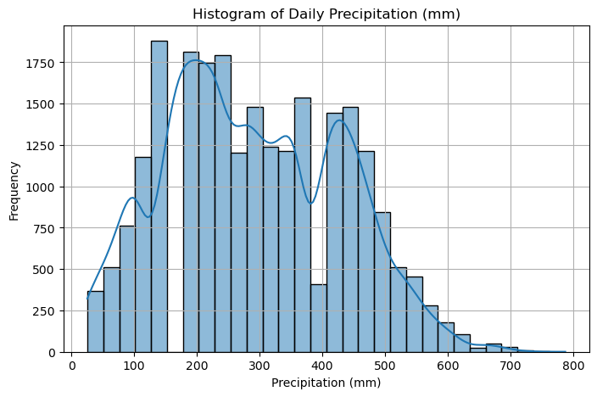
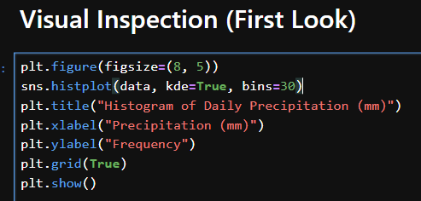
Visual Inspection (First Look)
👀
🧿 Objective:
Get an initial sense of the data's shape and spread.
✅ How:
Use histograms, box plots, or density plots. Identify skewness, modality, and outliers.
ss
ss
Lab File: lab1.ipynb

Slide 70
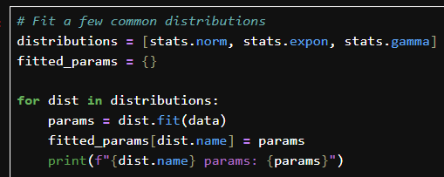
Fit Common Distributions
🛠️
🔧 Objective:
Try fitting known distributions to the data.
✅ How:
Use scipy.stats to fit and extract parameters.
ss
ss
Lab File: lab1.ipynb

Slide 71

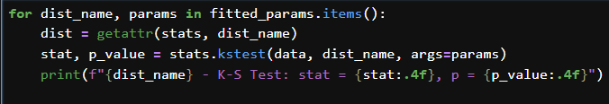
Goodness-of-Fit Tests
⚖️
🔧 Objective:
Check how well a theoretical distribution matches data.
✅ Common Tests:
Kolmogorov–Smirnov (K–S) Test
Anderson–Darling Test
Chi-Square Test.
ss
ss
Lab File: lab1.ipynb

Slide 72
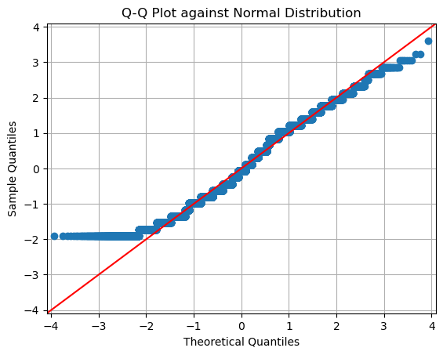
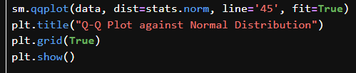
Q-Q Plot (Quantile-Quantile Plot)
🧮
🔧 Objective:
Compare quantiles of the sample vs. theoretical distribution.
✅ Insight:
If points lie on the 45° line, the fit is good.
ss
ss
Lab File: lab1.ipynb

Slide 73
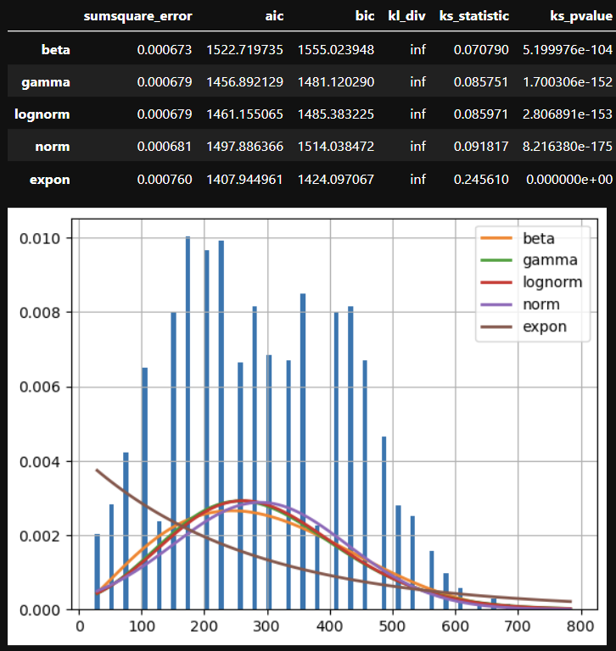
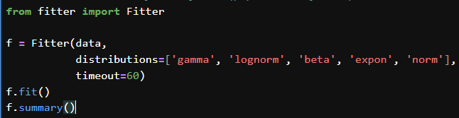
Use Distribution Fitting Libraries
🤖
🔧 Objective:
Use automated tools to compare many distributions efficiently.
✅ Tools:
Fitter distfit, scikit-gof.
ss
ss
Lab File: lab1.ipynb

Slide 74
Predicting Values Using Distribution

Slide 75
Predicting Values Using Distribution
🔍 Core Insight
If a distribution has a well-defined inverse CDF (quantile function), it can be used to predict rare or extreme events.
This is the basis of Return Level and Return Period analysis.
Commonly used in: 🔹 Climate extremes (floods, heatwaves) 🔹 Finance (losses) 🔹 Engineering (load capacity)

Slide 76

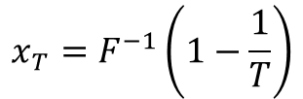

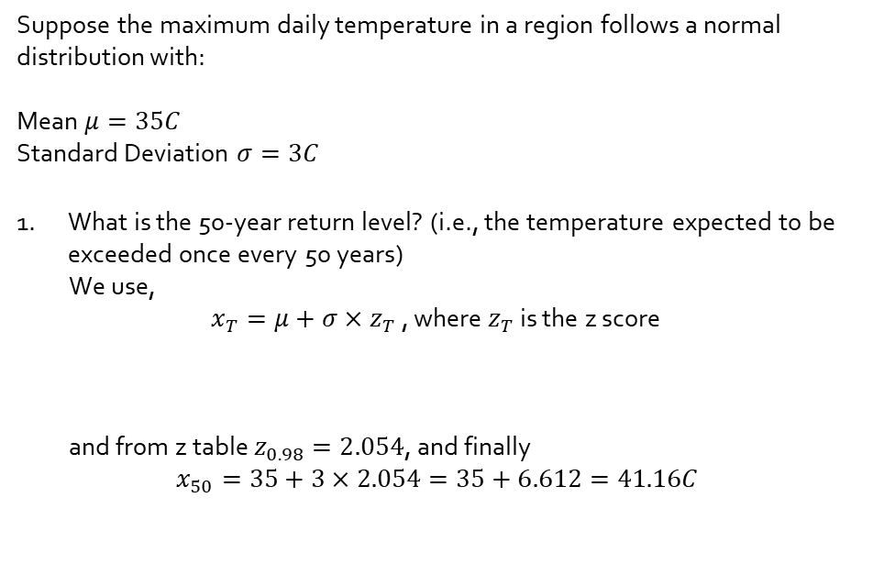
Two-Way Prediction
ss
ss
1. Predict Return Level (Threshold Value)
ss
ss
Suppose the maximum daily temperature in a region follows a normal distribution with:
Mean $μ=35C$
Standard Deviation $σ=3C$
What is the 50-year return level? (i.e., the temperature expected to be exceeded once every 50 years)
We use,
$x_{T}=μ+σ×z_{T}$ , where $z_{T}$ is the z score
and from z table $z_{0.98}=2.054$, and finally
$$x_{50}=35+3×2.054=35+6.612=41.16C$$
$$x_{T}=F^{−1}\left(1−\frac{1}{T}\right)$$
What is the value expected to be exceeded once every T years?
ss
ss
2. Predict Return Period (Rarity of a Value)
$$z_{T}=\left(1−\frac{1}{T}\right)=\left(1−\frac{1}{50}\right)=0.98$$
$$T=\frac{1}{1−F(x)}$$
How often will an event greater than x occur?

Slide 77
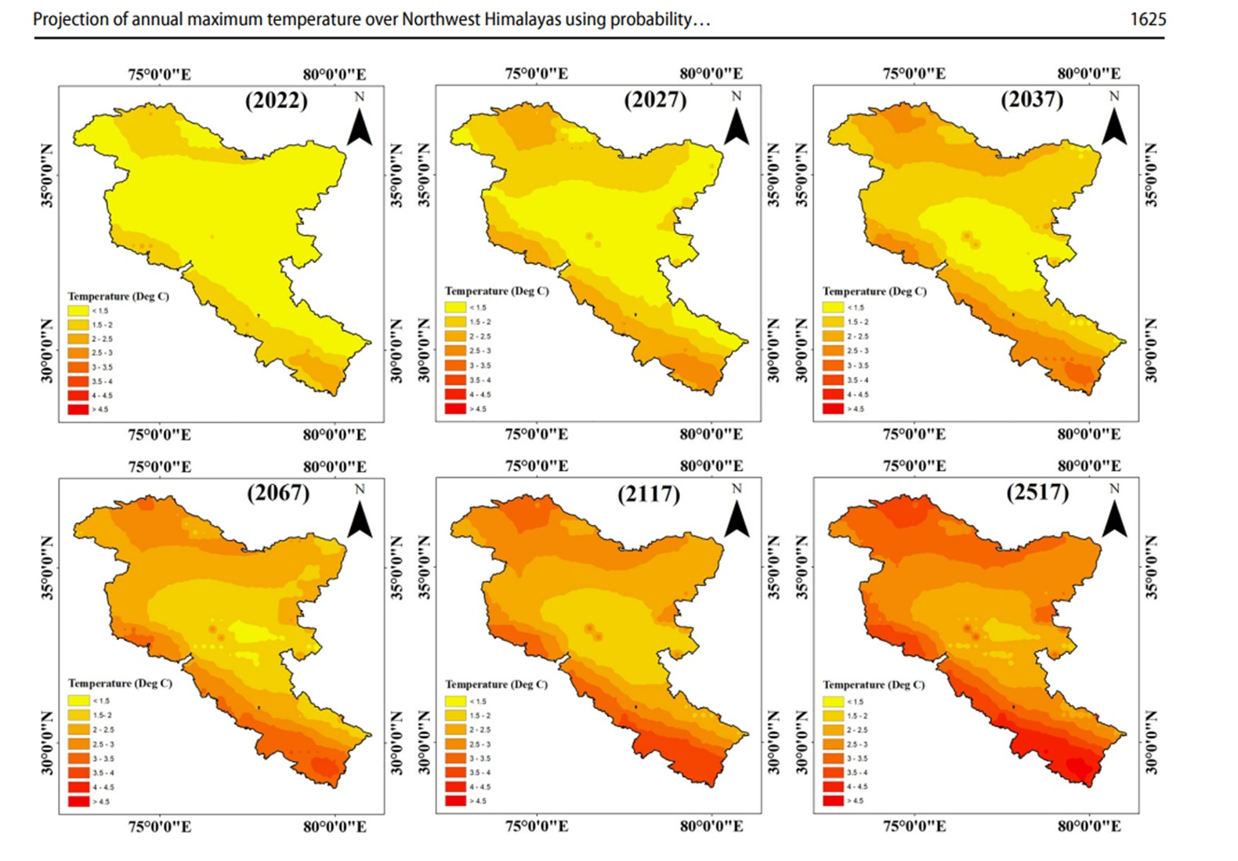
Extending previous example
ss
ss
ss
ss
1. Predict Return Level (Threshold Value)
In the previous slide we predicted one value of temperature for one year.
In the corresponding image, that idea has been extended for entire region and for multiple years.

Slide 78
Any Distribution Works – If Invertible
📈 This method works with:
✅ You’re not restricted to just GEV — any distribution with inverse CDF can be used for prediction!
Distribution | Use Case | Method
Normal | General natural processes | norm.ppf, norm.cdf
Exponential | Time between events | expon.ppf, expon.cdf
Gumbel | Extremes (e.g. max rainfall) | gumbel_r.ppf, gumbel_r.cdf
GEV | Generalized extremes | genextreme.ppf, genextreme.cdf
Lognormal | Skewed data | lognorm.ppf, lognorm.cdf

Slide 79
Summarizing Introduction to probability
Probability helps quantify uncertainty and reveal patterns in data by modeling how likely outcomes are.
Every variable — height, rainfall, income — has a shape. That shape is a distribution. Understanding this shape reveals patterns we otherwise miss.

Slide 80
Thank you
Dr. Sarita Azad
sarita@iitmandi.ac.in
faculty.iitmandi.ac.in/~sarita/

